Slide 1
Emerging Technologies for the Circular Economy
Lecture 14: The Machine-to-Everything (M2X) Economy
- A step towards the Circular Economy 2.0?
Prof. Dr. Benjamin Leiding (Clausthal)
M.Sc. Arne Bochem (Göttingen)
M.Sc. Anant Sujatanagarjuna (Clausthal)

Slide 2
License
This work is licensed under a Creative Commons Attribution-ShareAlike 4.0 International License. To view a copy of this license, please refer to https://creativecommons.org/licenses/by-sa/4.0/ .
Updated versions of these slides will be available in our Github repository.

Slide 3
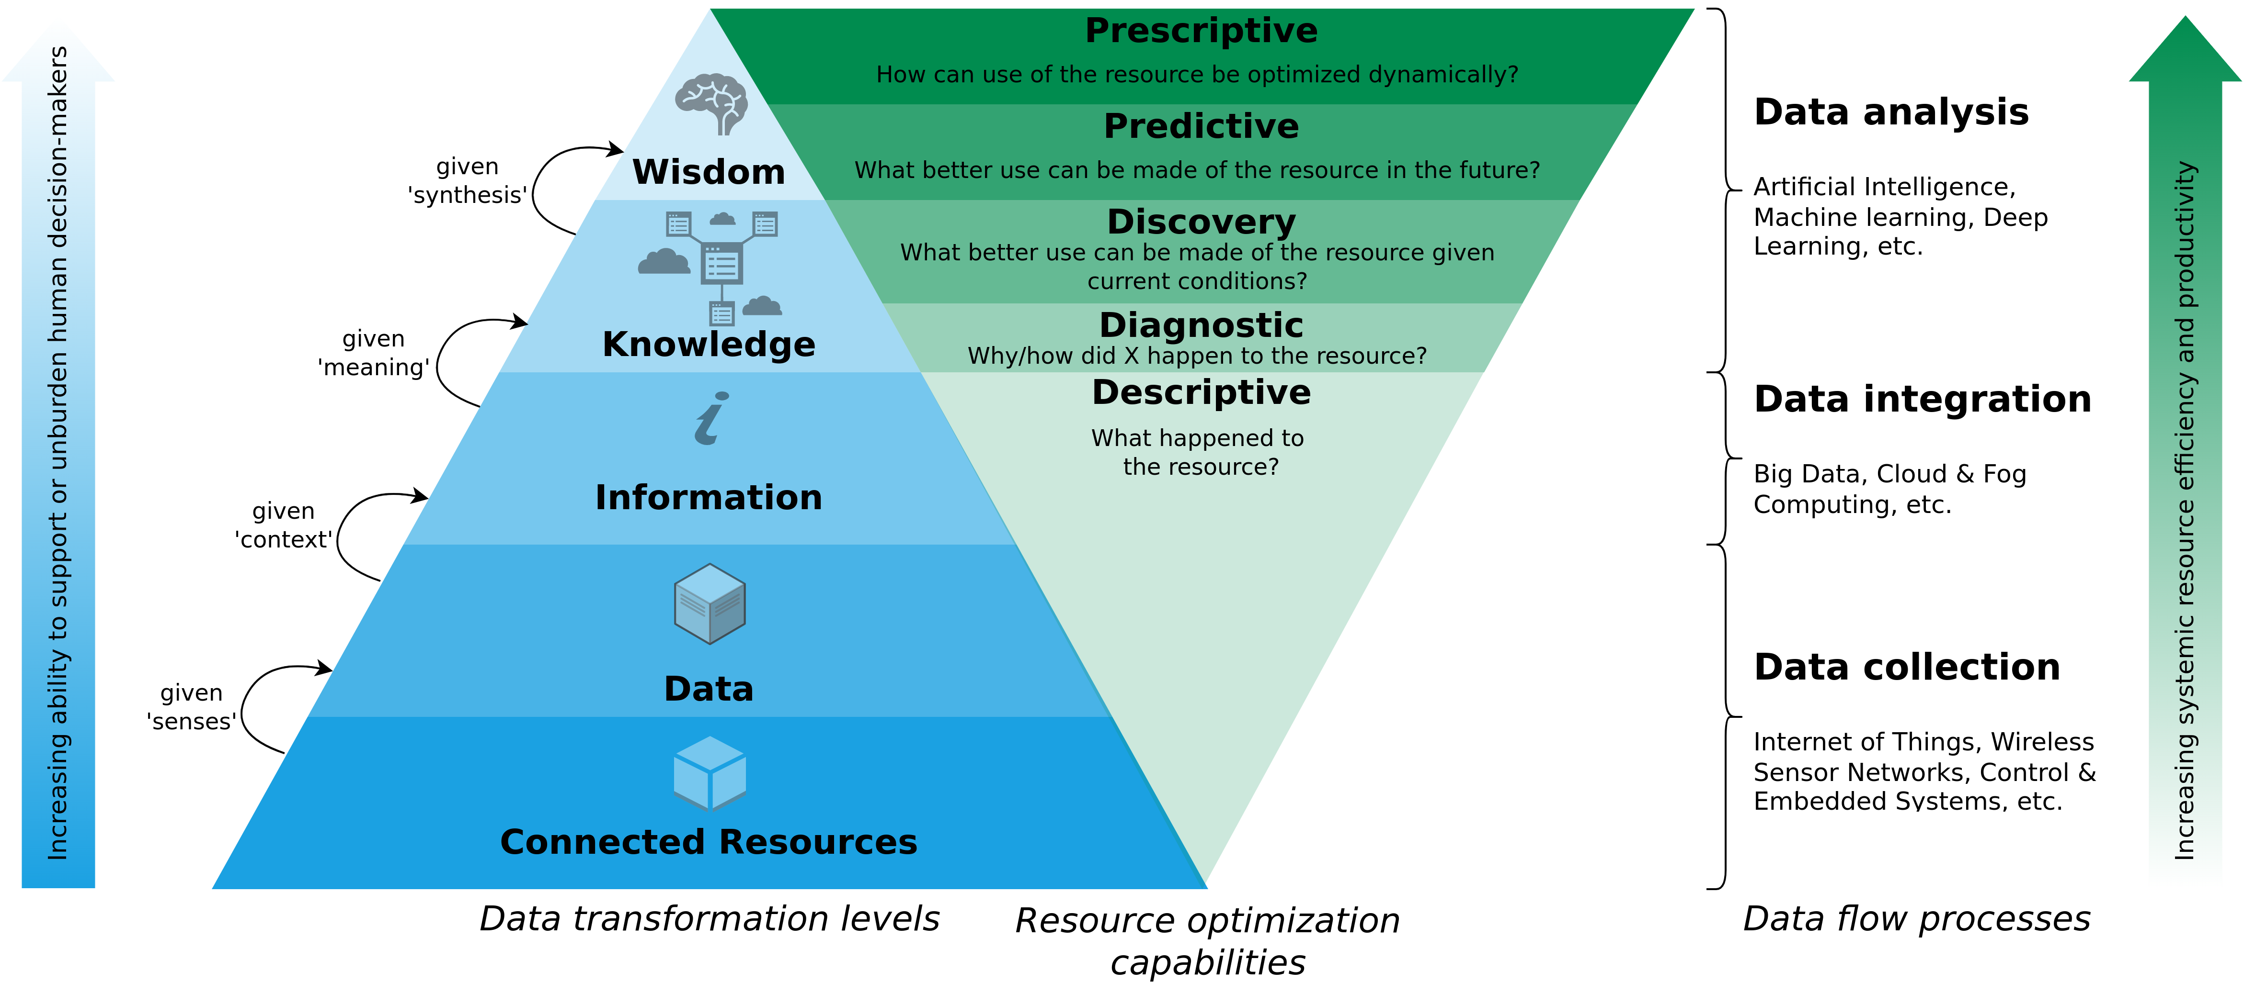
A Data-Driven Smart Circular Economy Framework
Image recreated based on Kristoffersen et al. (2020) – The smart circular economy: A digital-enabled circular strategies framework for manufacturing companies.

Slide 4
The Nature of Technology
In the past many new technologies have emerged and disrupted existing economical models.
B. Arthur stipulates that an economy is an expression of its technologies
Thus, it can be argued that the current unsatisfying state of the Circular Economy reflects a lack of sufficiently developed technologies that express themselves within the CE.
Or, more precisely – difficulties of the stakeholders in combining the technologies that are required to enable the CE.
Arthur, Brian (2011) – The Nature of Technology: What It Is and How It Evolves.

Slide 5
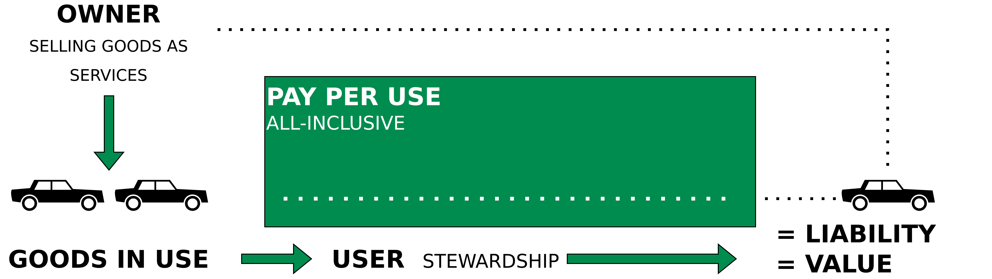
Performance Economy to Sharing Economy
Image recreated based on Walter R. Stahel (2019) – The Circular Economy: A User’s Guide.

Slide 6
Introduction

Slide 7

Machine-to-Human (M2H)
Machine-to-Human (M2H)
For example → Transportation-as-a-Service
Image recreated based on https://chorus.mobi

Slide 8

Machine-to-Machine (M2M)
Machine-to-Machine (M2M)
For example → Road space negotiations
Image recreated based on https://chorus.mobi

Slide 9

Machine-to-Infrastructure (M2I)
Machine-to-Infrastructure (M2I)
For example → Smart parking, electric vehicle charging or traffic information
Image recreated based on https://chorus.mobi

Slide 10
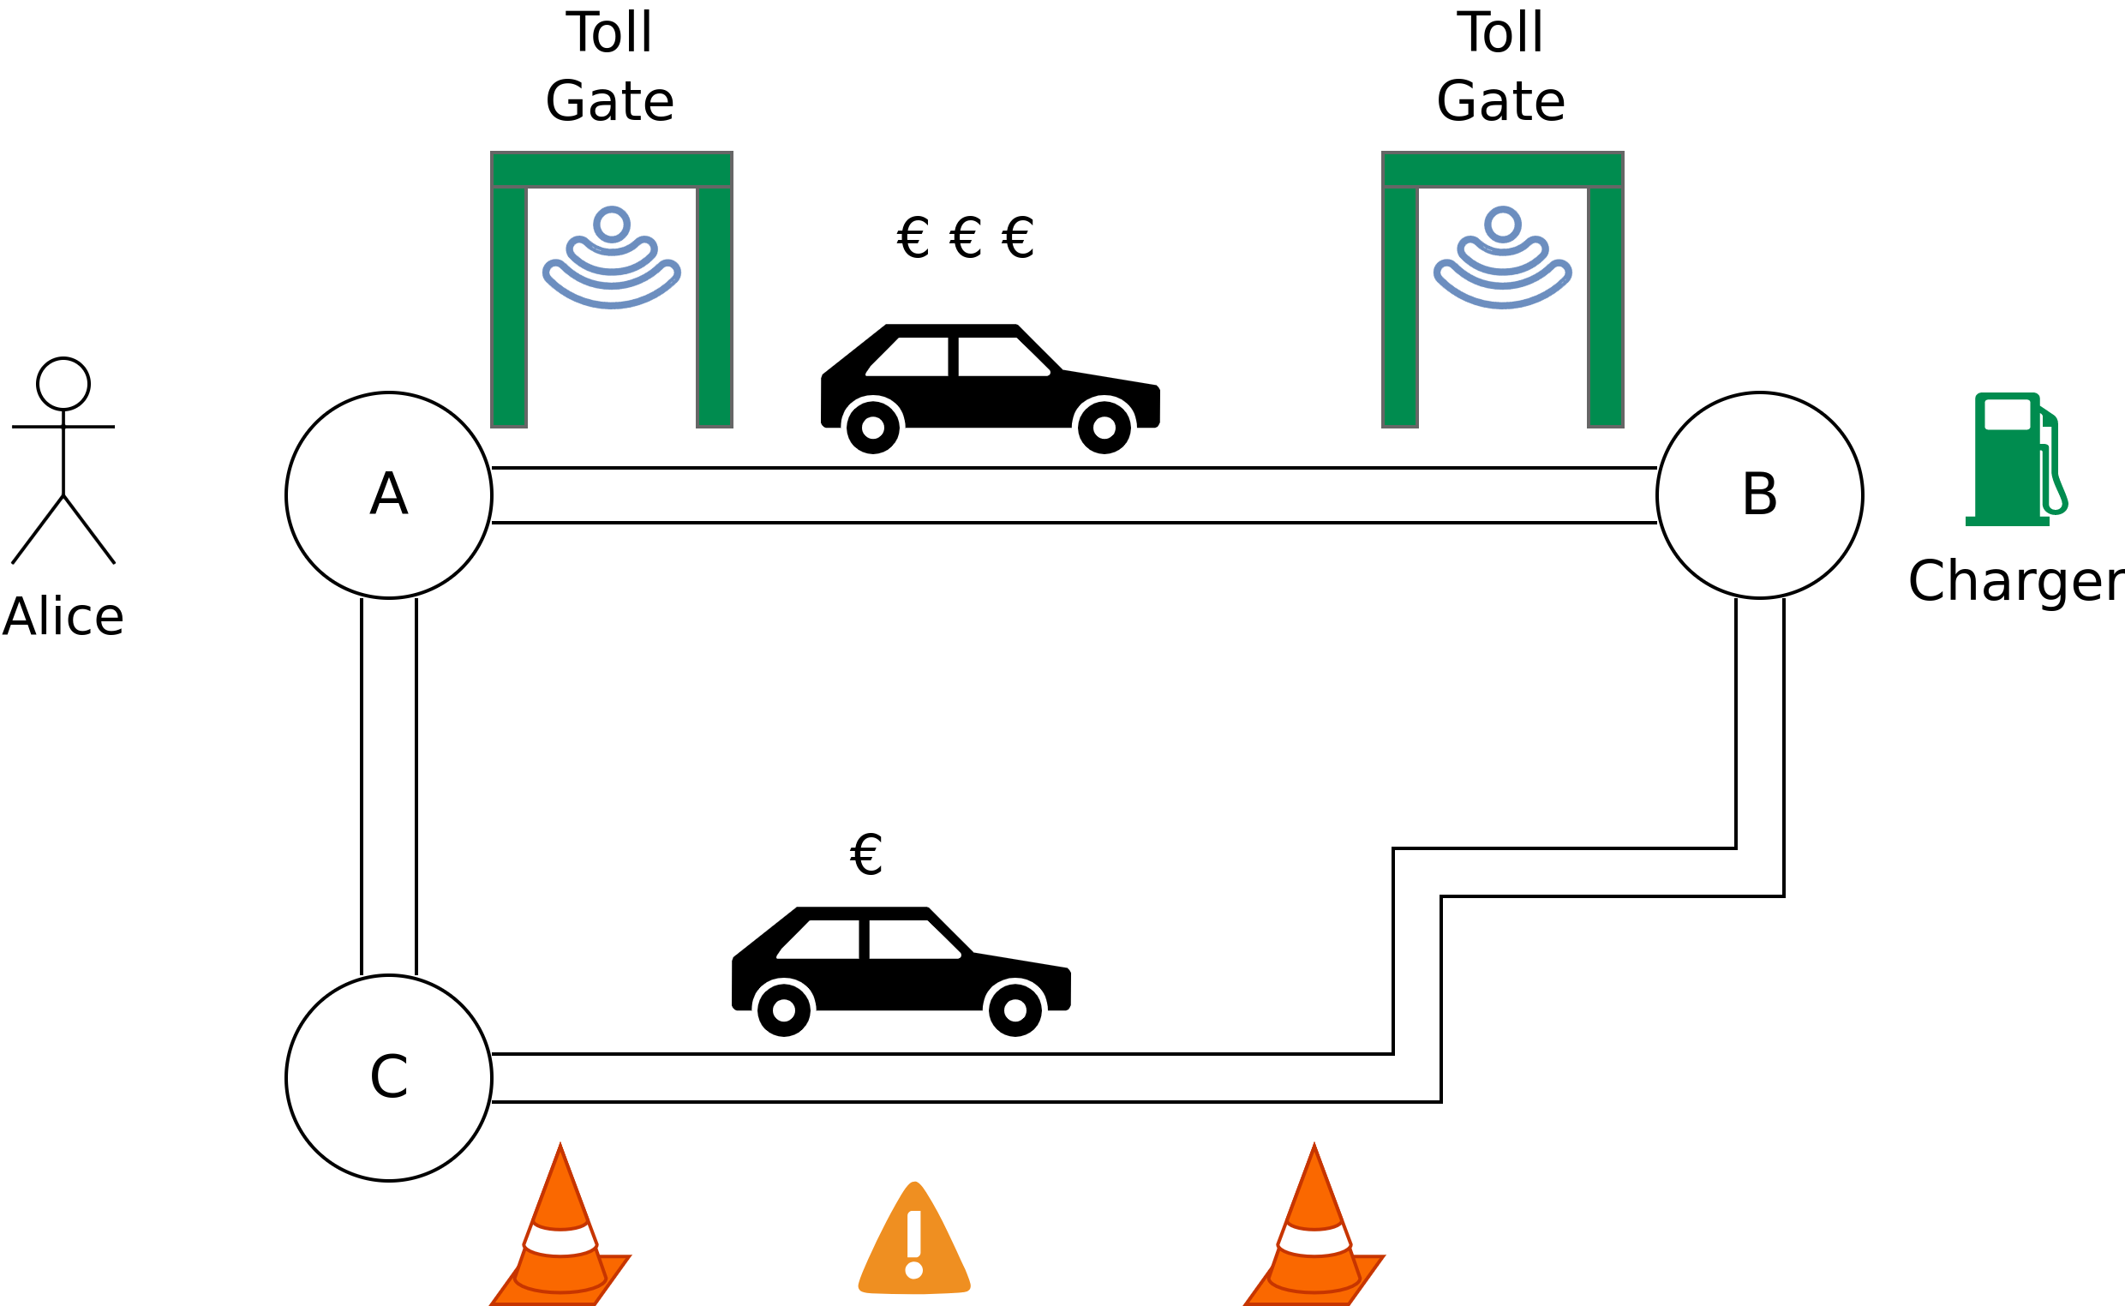
Running Case

Slide 11
MOBI Grand Challenge 2019 – Chorus Mobility
Transforming Urban Mobility
MOBI Grand Challenge Submission Video
https://chorus.mobi

Slide 12
The M2X Economy

Slide 13
M2X Economy
Machine-to-Human (M2H)
+
Machine-to-Machine (M2M)
+
Machine-to-Infrastructure (M2I)
=
Machine-to-Everything (M2X)
<number>

Slide 14
M2X Economy
Machine-to-Human (M2H)
+
Machine-to-Machine (M2M)
+
Machine-to-Infrastructure (M2I)
=
Machine-to-Everything (M2X)
M2X Economy → Is the result of business interactions, transactions and collaborations among entities of the M2X ecosystem.
<number>

Slide 15
M2X Economy – Definition
“The M2X Economy is the result of interactions, transactions, collaborations and business enactments among humans, autonomous and cooperative smart devices, software agents, and physical systems.
The corresponding ecosystem is formed by automated, globally-available, heterogeneous socio-technical e-governance systems with loosely coupled, P2P-resembling network structures and is characterized by its dynamic, continuously changing, interoperable, open and distributed nature. Thereby, the M2X Economy employs concepts such as cyber-physical systems, the Internet of Things, and wireless sensor networks.”
B. Leiding, P. Sharma, A. Norta, “The Machine-to-Everything (M2X) Economy: Business Enactments, Collaborations, and e-Governance”, Future Internet 13.12 (2021): 319.

Slide 16
M2X Economy – Definition
“The M2X Economy is the result of interactions, transactions, collaborations and business enactments among humans, autonomous and cooperative smart devices, software agents, and physical systems.
The corresponding ecosystem is formed by automated, globally-available, heterogeneous socio-technical e-governance systems with loosely coupled, P2P-resembling network structures and is characterized by its dynamic, continuously changing, interoperable, open and distributed nature. Thereby, the M2X Economy employs concepts such as cyber-physical systems, the Internet of Things, and wireless sensor networks.”
B. Leiding, P. Sharma, A. Norta, “The Machine-to-Everything (M2X) Economy: Business Enactments, Collaborations, and e-Governance”, Future Internet 13.12 (2021): 319.

Slide 17
State of the Art – IoT, CPS, WSN, etc.
Cyber Physical Systems (CPS)
Internet of Things (IoT)
Wireless Sensor Networks (WSN)

Slide 18
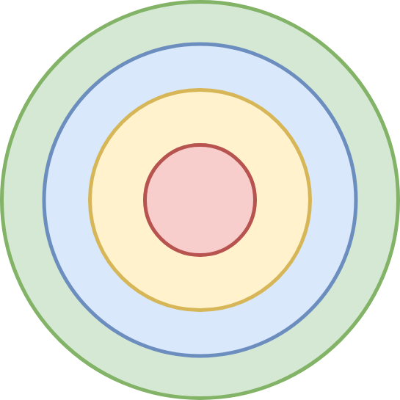
State of the Art – IoT, CPS, WSN, etc.
Wireless Sensor Networks
Cyber Physical Systems (CPS)
Internet of Things
Internet of Things (IoT)
Wireless Sensor Networks (WSN)
Cyber Physical Systems
Industry 4.0

Slide 19
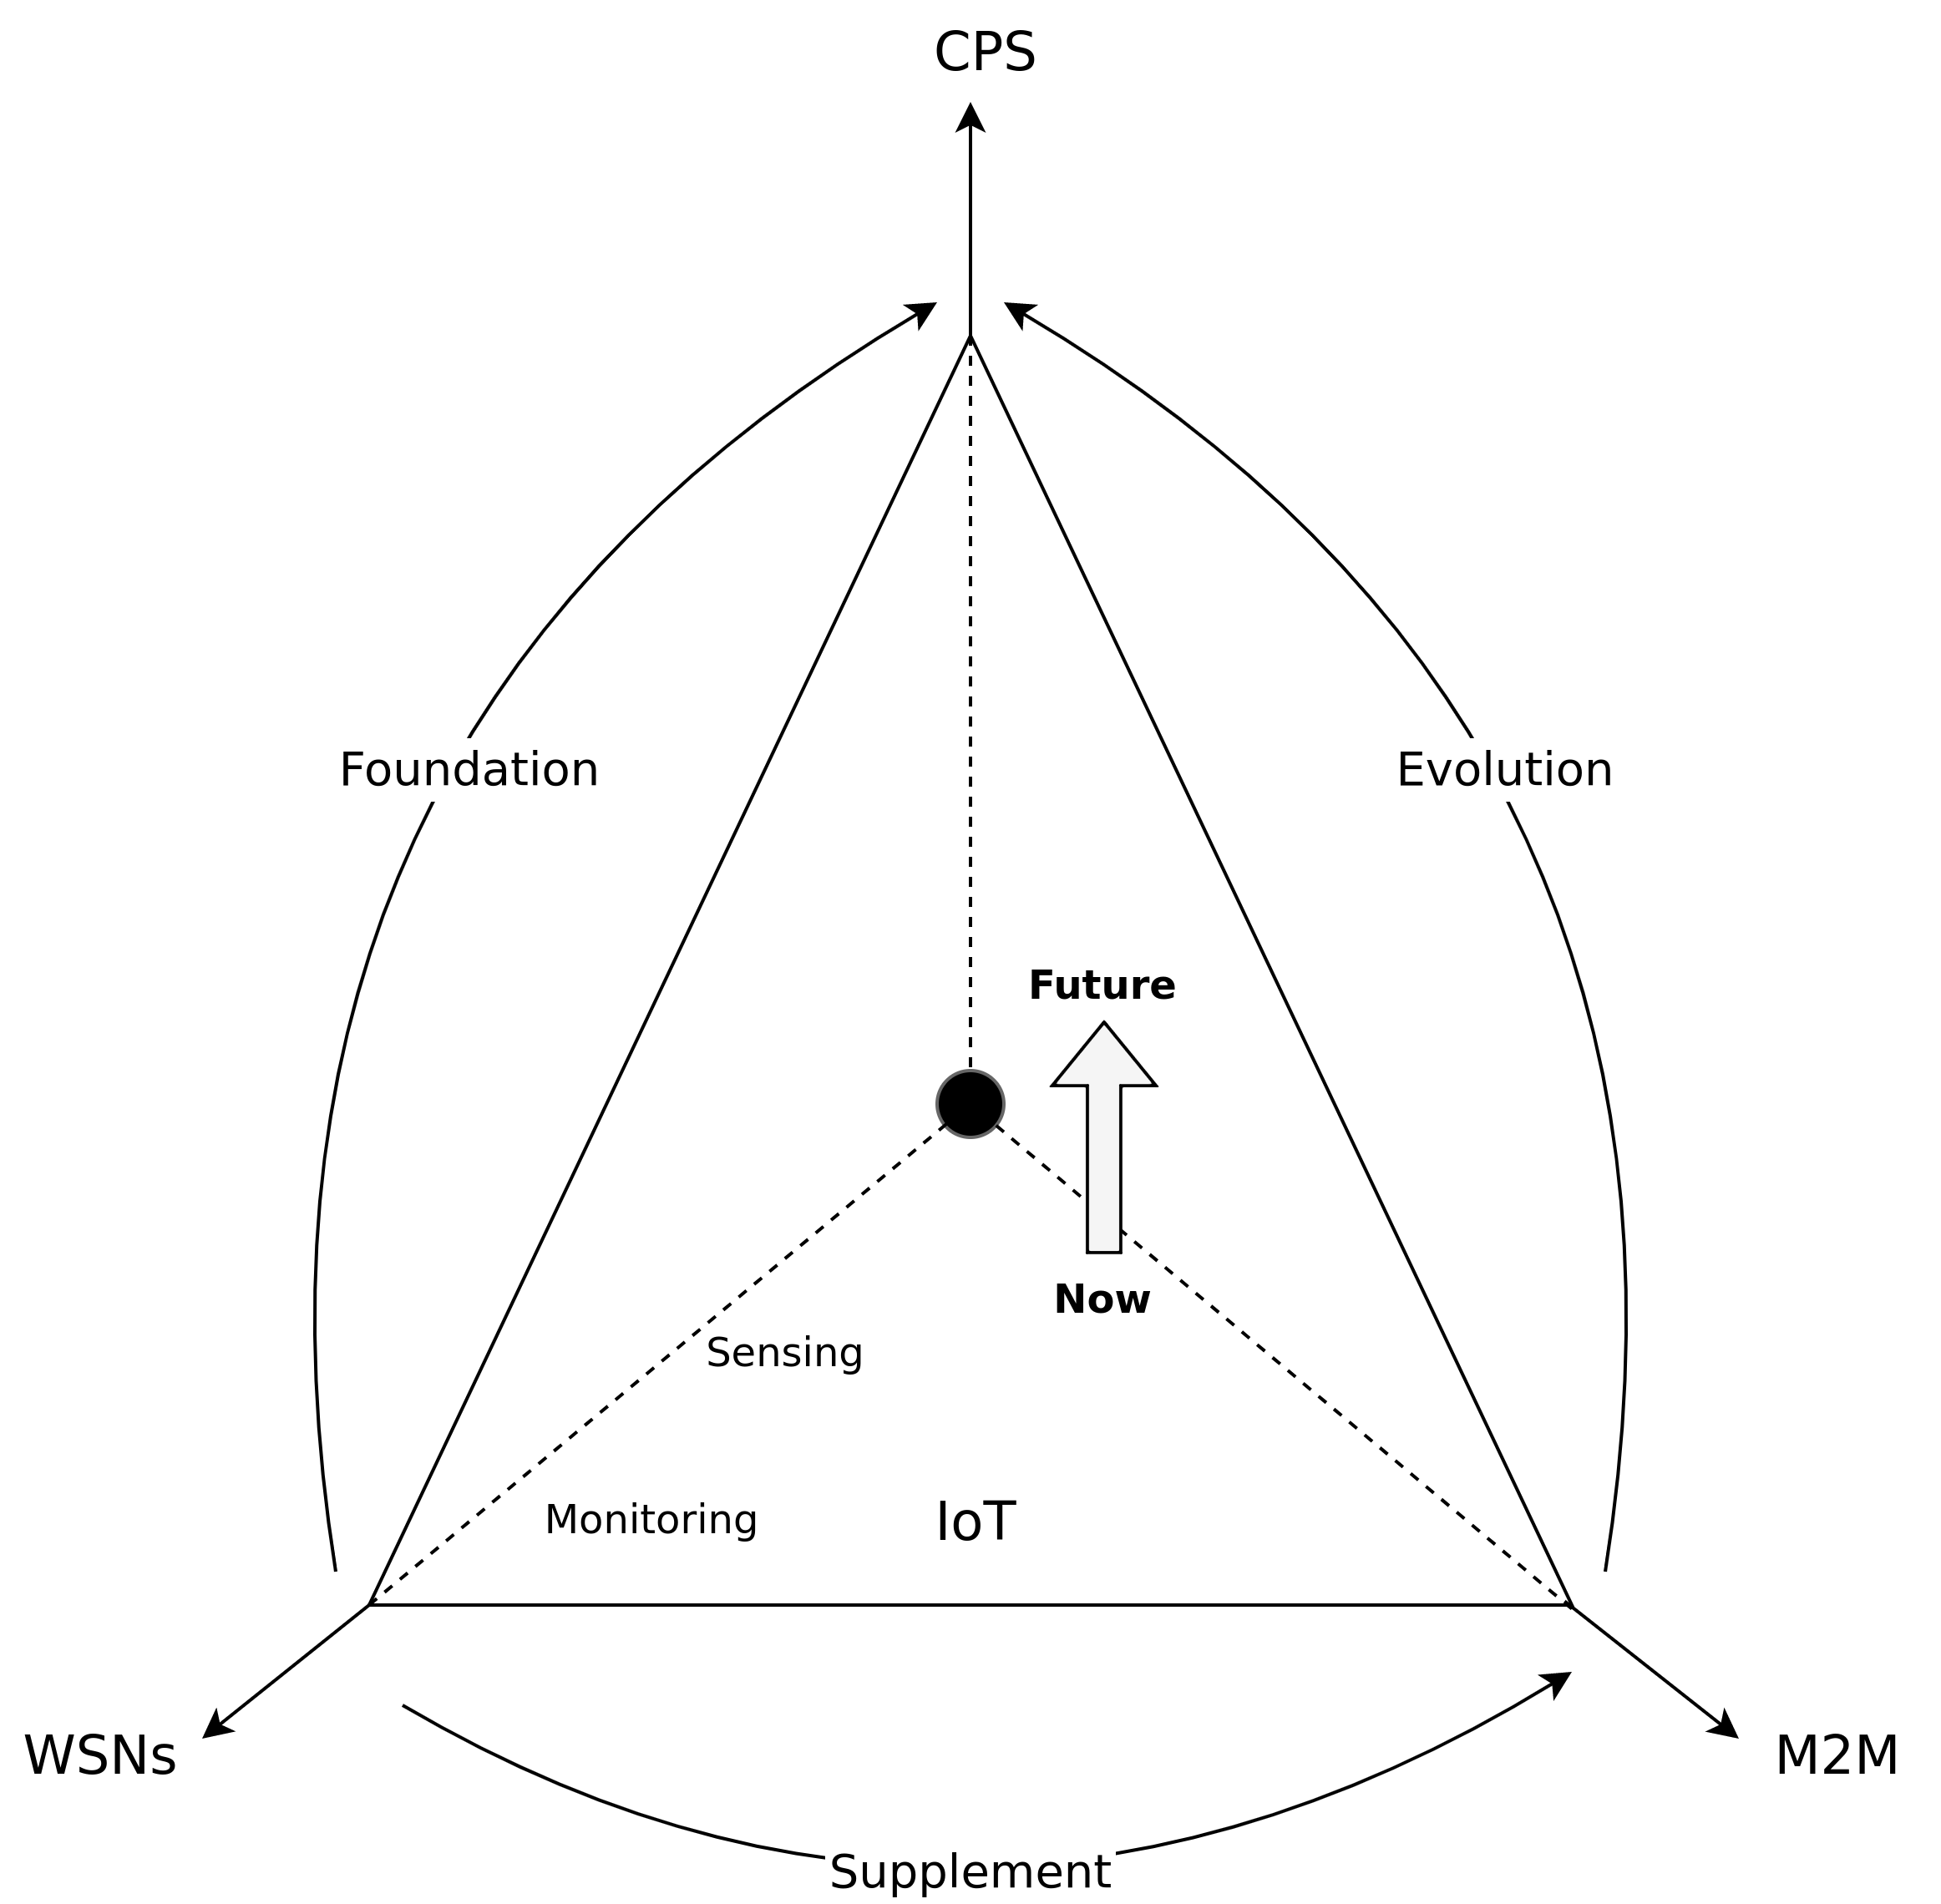
State of the Art – IoT, CPS, WSN, etc.
Cyber Physical Systems (CPS)
Internet of Things (IoT)
Wireless Sensor Networks (WSN)
Based on: Misic and Misic (2014) – Machine-to-Machine Communications: Architectures, Technology, Standards, and Applications.

Slide 20
What is missing?
M2X Economy
Cyber Physical Systems (CPS)
?
Internet of Things (IoT)
Wireless Sensor Networks (WSN)

Slide 21
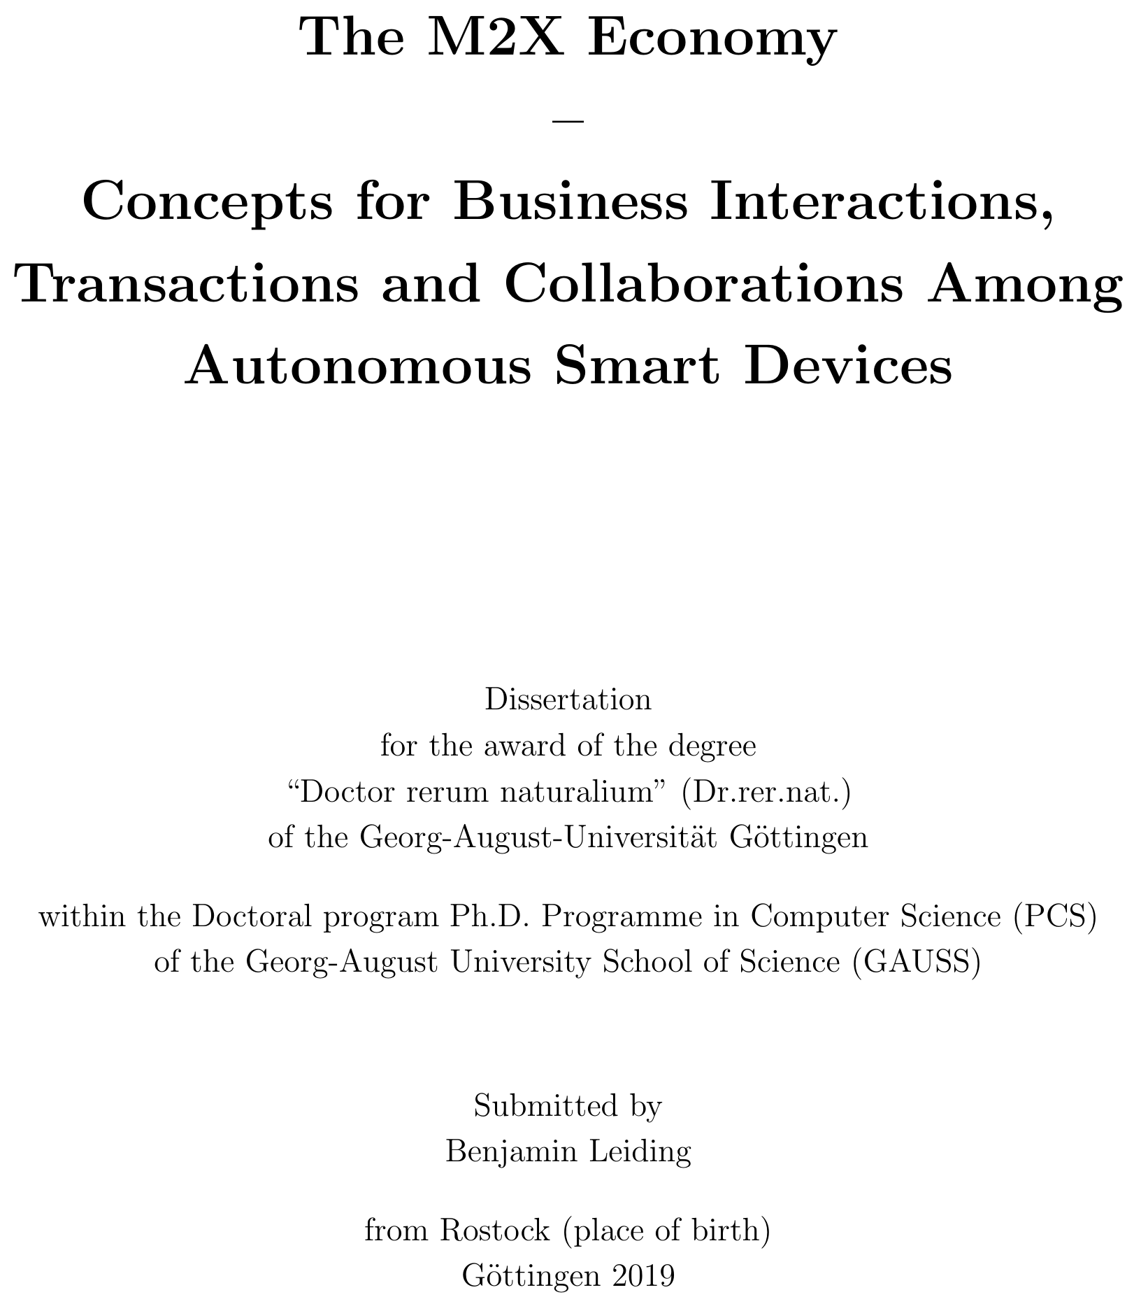
What is missing?

Slide 22
The M2X Economy – Building Blocks

Slide 23
Everything is a Contract
TaaS, road space negotiations, smart parking, electric vehicle charging, toll gate payments, etc.
→ Roughly the same process
What are the similarities?
Can we model all steps as a contractual process?
Why would we want to do that?
Abstraction towards a general lifecycle for value exchange, collaborations, and business enactments of the M2X Economy
→ We stipulate that all M2X-related interactions, transactions, collaborations, and further enactments can be governed and represented using a blockchain-based smart contract.

Slide 24
Everything is a Contract
TaaS, road space negotiations, smart parking, electric vehicle charging, toll gate payments, etc.
→ Roughly the same process
What are the similarities?
Can we model all steps as a contractual process?
Why would we want to do that?
Abstraction towards a general lifecycle for value exchange, collaborations, and business enactments of the M2X Economy
→ We stipulate that all M2X-related interactions, transactions, collaborations, and further enactments can be governed and represented using a blockchain-based smart contract.

Slide 25
Everything is a Contract
TaaS, road space negotiations, smart parking, electric vehicle charging, toll gate payments, etc.
→ Roughly the same process
What are the similarities?
Can we model all steps as a contractual process?
Why would we want to do that?
Abstraction towards a general lifecycle for value exchange, collaborations, and business enactments of the M2X Economy
→ We stipulate that all M2X-related interactions, transactions, collaborations, and further enactments can be governed and represented using a blockchain-based smart contract.

Slide 26
Everything is a Contract
TaaS, road space negotiations, smart parking, electric vehicle charging, toll gate payments, etc.
→ Roughly the same process
What are the similarities?
Can we model all steps as a contractual process?
Why would we want to do that?
Abstraction towards a general lifecycle for value exchange, collaborations, and business enactments of the M2X Economy
→ We stipulate that all M2X-related interactions, transactions, collaborations, and further enactments can be governed and represented using a blockchain-based smart contract.

Slide 27
Contracts
Traditional understanding of a contract:
Written or spoken agreement enforceable by law
Parties involved voluntarily engage to establish a consensus

Slide 28
Contracts
Traditional understanding of a contract:
Written or spoken agreement enforceable by law
Parties involved voluntarily engage to establish a consensus
In most business cases, contracts:
are documents
identify the contracting parties uniquely
describe service that is offered for some form of compensation
list a set of additional clauses such as service-delivery dates, penalties, etc.

Slide 29
Contracts
But traditional contracts:
are often underspecified → does not work for machines
do not provide sufficient details about the actual transaction process
→ friction between the contracting parties, e.g., one party assumes a specific product certificate before delivering a partial compensation and the other party assumes the opposite
Deadlocks lead to costly conflict resolutions, or even a collapse of the entire contract transaction.
Enforcement of traditional contracts proves to be either too complicated, time consuming, or impossible, certainly in international circumstances.

Slide 30
Contracts
But traditional contracts:
are often underspecified → does not work for machines
do not provide sufficient details about the actual transaction process
→ friction between the contracting parties, e.g., one party assumes a specific product certificate before delivering a partial compensation and the other party assumes the opposite
Deadlocks lead to costly conflict resolutions, or even a collapse of the entire contract transaction.

Slide 31
Contracts
But traditional contracts:
are often underspecified → does not work for machines
do not provide sufficient details about the actual transaction process
→ friction between the contracting parties, e.g., one party assumes a specific product certificate before delivering a partial compensation and the other party assumes the opposite
Deadlocks lead to costly conflict resolutions, or even a collapse of the entire contract transaction.
Enforcement of traditional contracts proves to be either too complicated, time consuming, or impossible, certainly in international circumstances.

Slide 32
Electronic Contracts
So what is the solution?
Electronic smart contracts
Enable and govern business transactions using a computerized transaction protocol such as a blockchain
mart contracts are computer programs for the consistent execution by a network of mutually distrusting nodes where no arbitration of a trusted authority exists
Readable/processable by machines and humans alike
→ Fact tracking, non-repudiation, auditability, and tamper-resistant storage of information in a distributed multi-stakeholder setting, e.g., the M2X Economy.

Slide 33
Electronic Contracts
So what is the solution?
Electronic smart contracts
Enable and govern business transactions using a computerized transaction protocol such as a blockchain
Smart contracts are computer programs for the consistent execution by a network of mutually distrusting nodes where no arbitration of a trusted authority exists
Readable/processable by machines and humans alike
→ Fact tracking, non-repudiation, auditability, and tamper-resistant storage of information in a distributed multi-stakeholder setting, e.g., the M2X Economy.

Slide 34
Blockchain Technology
Append-only data structure secured by interconnected hashes
Distributed and decentralized data storage with a global consensus mechanism
Neutral territory between stakeholders
Immutability
Non-repudiation and auditability

Slide 35
Blockchain Technology
Append-only data structure secured by interconnected hashes
Distributed and decentralized data storage with a global consensus mechanism
Neutral territory between stakeholders
Immutability
Non-repudiation and auditability
Enables Smart Contracts:
On-chain programs → State changes stored on-chain
Autonomous, deterministic and auditable execution of programs

Slide 36
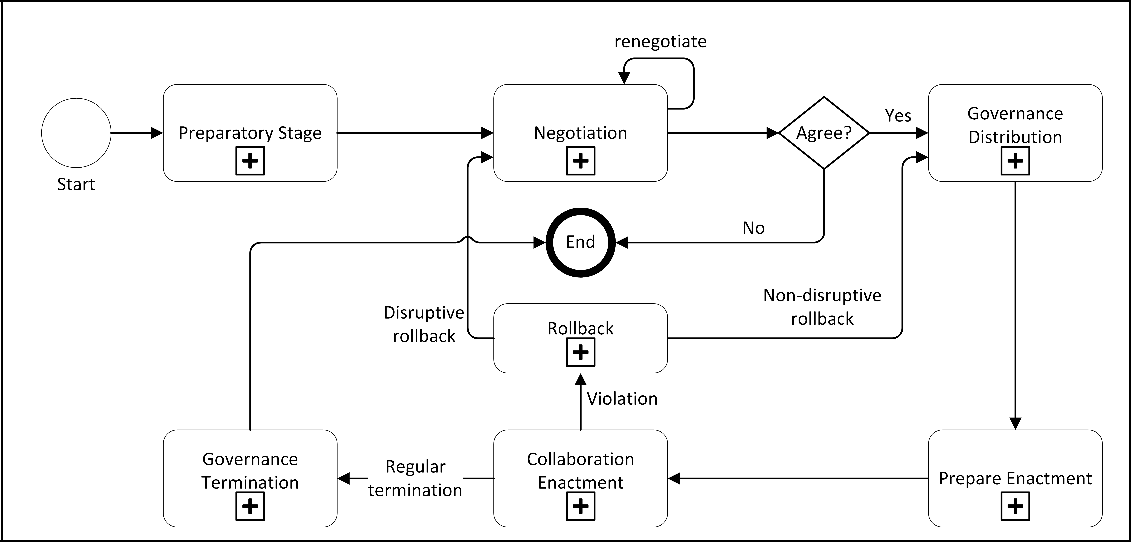
Digital Contract Lifecycle
Based on: Leiding (2020) – The M2X Economy – Concepts for Business Interactions, Transactions and Collaborations Among Autonomous Smart Devices
Norta (2016) – Designing a Smart-Contract Application Layer for Transacting Decentralized Autonomous Organizations
Norta (2015) – Creation of Smart-Contracting Collaborations for Decentralized Autonomous Organizations
Norta (2015) – Establishing Distributed Governance Infrastructures for Enacting Cross-Organization Collaborations
Norta et al. (2015) –Conflict-Resolution Lifecycles for Governed Decentralized Autonomous Organization Collaboration

Slide 37
Lifecycle – Preparatory Stage
Select contract based on pre-configured templates provided by a corresponding business hub, e.g., blockchain
Collect entity-related information:
Identifiers
Wallet addresses
Location
Jurisdiction
Specify contract conditions:
Departure location
Final destination
Vehicle size
Departure/arrival time

Slide 38
Lifecycle – Negotiation
Negotiate an agreement among the involved stakeholders
Essentially:
Needs of the client (get from A to B) vs. needs of the service provider (compensation for service)
n case the entities agree on the negotiated conditions → All involved parties sign the contract and express their approval
In case no agreement is reached → Trigger contract rollback

Slide 39
Lifecycle – Negotiation
Negotiate an agreement among the involved stakeholders
Essentially:
Needs of the client (get from A to B) vs. needs of the service provider (compensation for service)
In case the entities agree on the negotiated conditions → All involved parties sign the contract and express their approval
In case no agreement is reached → Trigger contract rollback

Slide 40
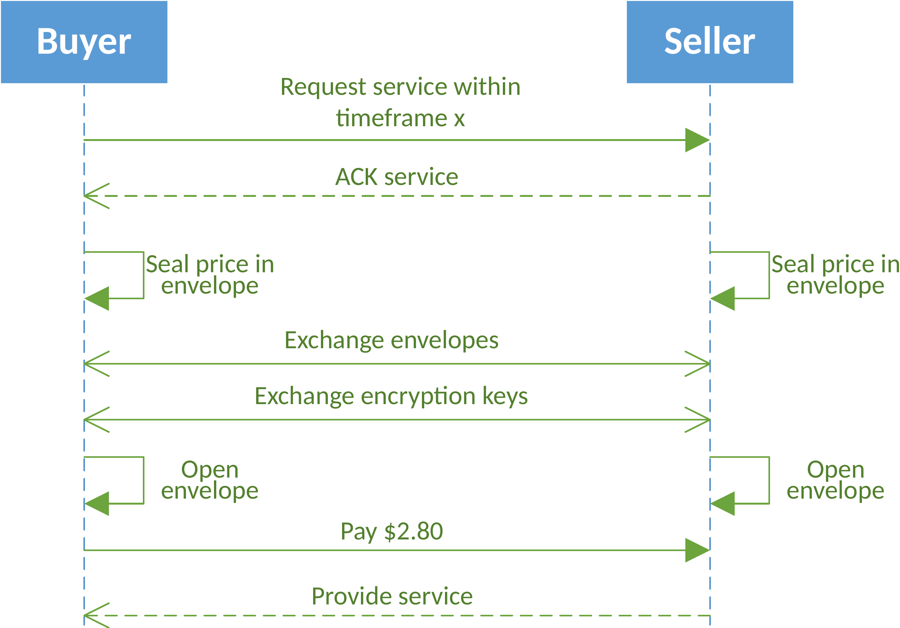
Auctions and Negotiations – 1-to-1
Leiding (2020) – The M2X Economy – Concepts for Business Interactions, Transactions and Collaborations Among Autonomous Smart Devices
Leiding and Vorobev (2018) – Enabling the V2X Economy Revolution Using a Blockchain-based Value Transaction Layer for Vehicular Ad-hoc Networks
Leiding and Vorobev (2019) – Enabling the Vehicle Economy Using a Blockchain-Based Value Transaction Layer Protocol for Vehicular Ad-Hoc Networks - Whitepaper

Slide 41
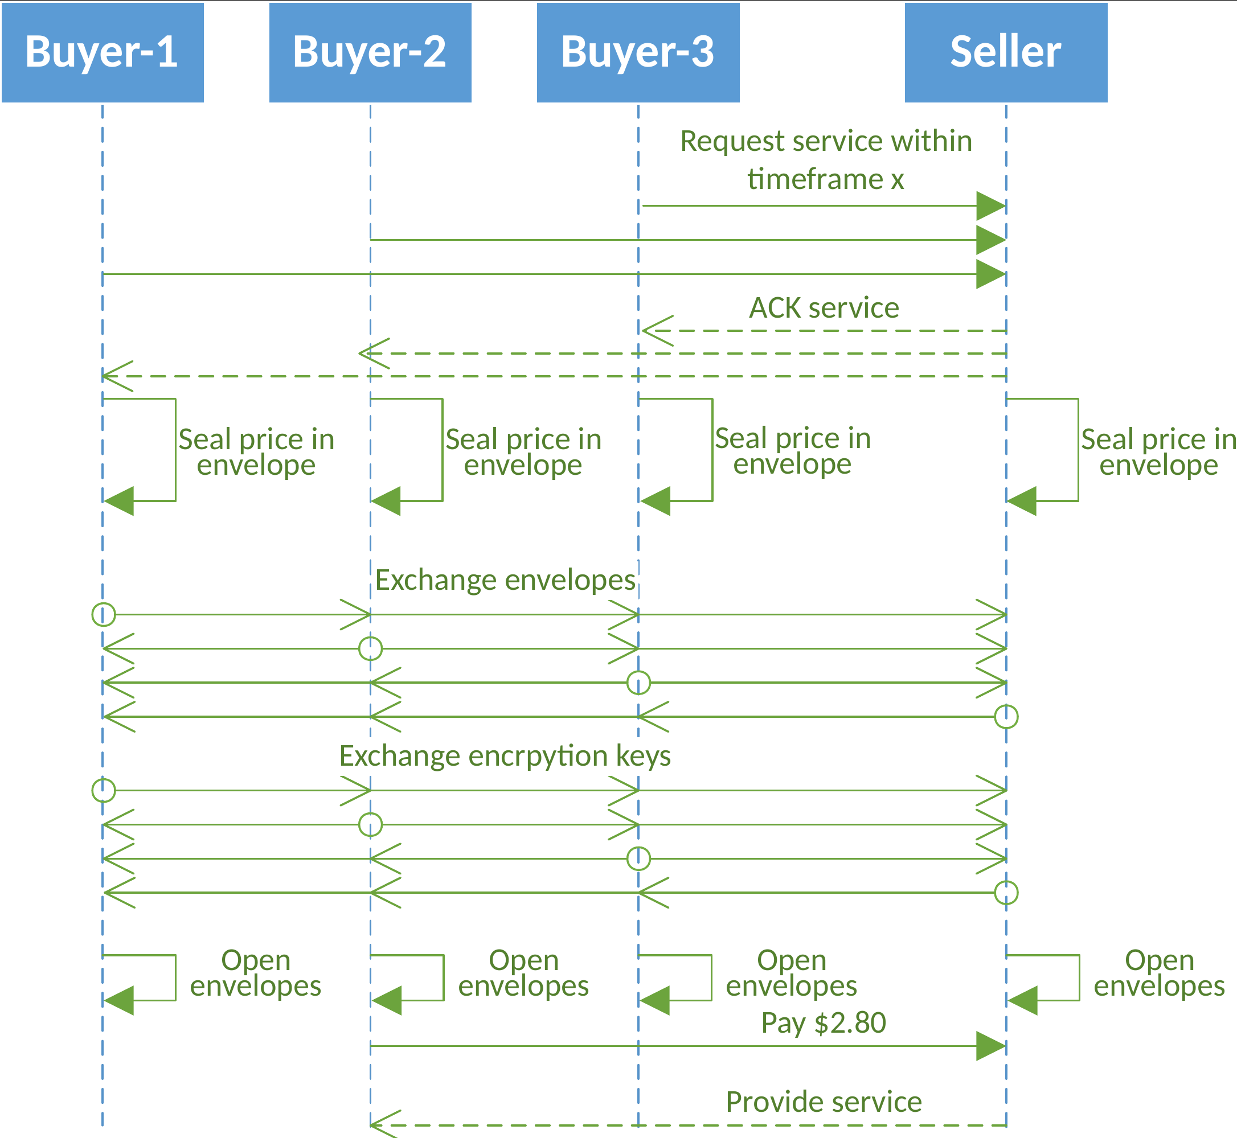
Auctions and Negotiations – 1-to-Many
Leiding (2020) – The M2X Economy – Concepts for Business Interactions, Transactions and Collaborations Among Autonomous Smart Devices
Leiding and Vorobev (2018) – Enabling the V2X Economy Revolution Using a Blockchain-based Value Transaction Layer for Vehicular Ad-hoc Networks
Leiding and Vorobev (2019) – Enabling the Vehicle Economy Using a Blockchain-Based Value Transaction Layer Protocol for Vehicular Ad-Hoc Networks - Whitepaper

Slide 42
Digital Contract Lifecycle
Based on: Leiding (2020) – The M2X Economy – Concepts for Business Interactions, Transactions and Collaborations Among Autonomous Smart Devices
Norta (2016) – Designing a Smart-Contract Application Layer for Transacting Decentralized Autonomous Organizations
Norta (2015) – Creation of Smart-Contracting Collaborations for Decentralized Autonomous Organizations
Norta (2015) – Establishing Distributed Governance Infrastructures for Enacting Cross-Organization Collaborations
Norta et al. (2015) –Conflict-Resolution Lifecycles for Governed Decentralized Autonomous Organization Collaboration

Slide 43
Lifecycle – Governance Distribution
A smart contract between the involved parties is established and serves as a DGI (distributed governance infrastructure)-coordinating agent
Each participating entity receives a local contract copy containing the rights and obligations of each party
e.g., transporting the user to the correct location
Obligations are observed by monitoring services or monitors, e.g., IoT-sensors

Slide 44
Lifecycle –Prepare Enactment
Prepare and provide concrete required process endpoints, e.g., for payment processing
Creation of communication endpoints so that the services of the partners are able to communicate with each other
Liveness check of connected services

Slide 45
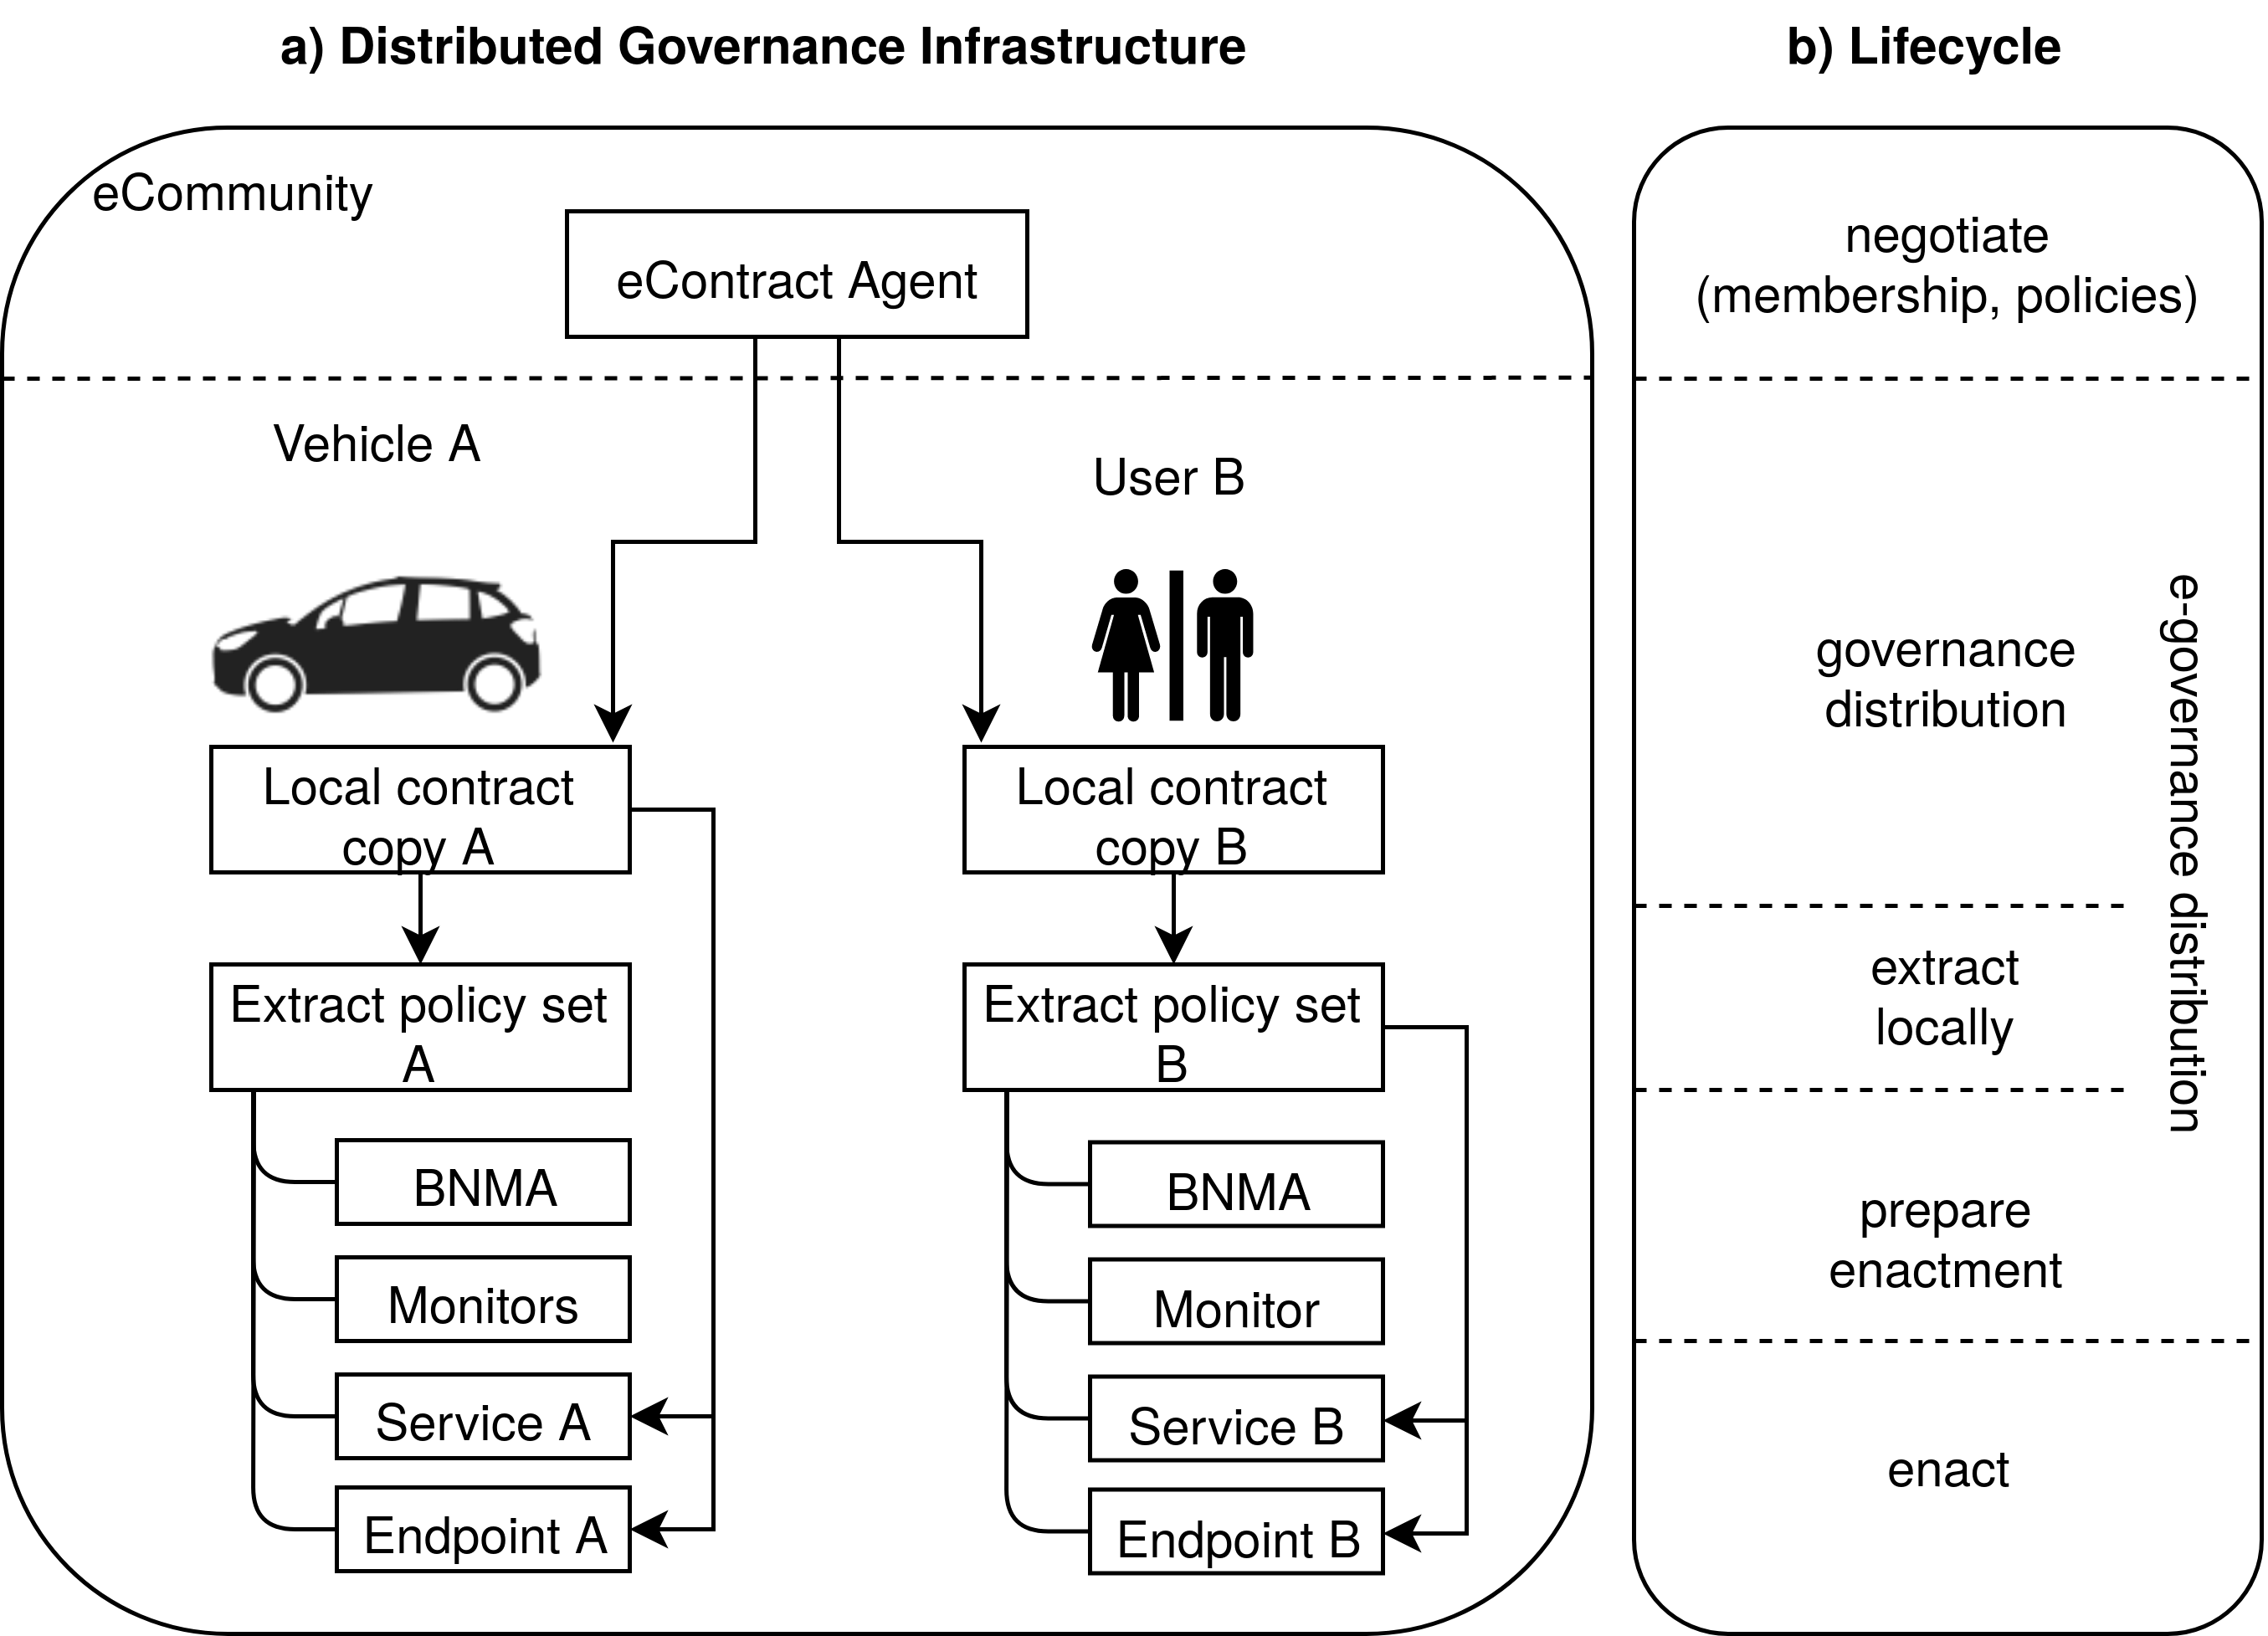
Governance
Based on: Leiding (2020) – The M2X Economy – Concepts for Business Interactions, Transactions and Collaborations Among Autonomous Smart Devices
Norta (2016) – Designing a Smart-Contract Application Layer for Transacting Decentralized Autonomous Organizations
Kutvonen et al. (2012) – Inter-Enterprise Business Transaction Management in Open Service Ecosystems

Slide 46
Lifecycle – Enactment
Pick up the user and transport the user to the final destination
Monitor contract obligations and check for violations

Slide 47
Digital Contract Lifecycle
Based on: Leiding (2020) – The M2X Economy – Concepts for Business Interactions, Transactions and Collaborations Among Autonomous Smart Devices
Norta (2016) – Designing a Smart-Contract Application Layer for Transacting Decentralized Autonomous Organizations
Norta (2015) – Creation of Smart-Contracting Collaborations for Decentralized Autonomous Organizations
Norta (2015) – Establishing Distributed Governance Infrastructures for Enacting Cross-Organization Collaborations
Norta et al. (2015) –Conflict-Resolution Lifecycles for Governed Decentralized Autonomous Organization Collaboration

Slide 48
Lifecycle – Conflict Resolution and Rollback
What if something goes wrong?
(failing to transport the user to the agreed-upon destination)
Two options:
Immediate rollback
Mediation process that is supervised by a conflict resolution escrow service
Can be calming or disruptive

Slide 49
Lifecycle – Conflict Resolution and Rollback
What if something goes wrong?
(failing to transport the user to the agreed-upon destination)
Two options:
Immediate rollback
Mediation process that is supervised by a conflict resolution escrow service
Can be calming or disruptive

Slide 50
Lifecycle – Governance Termination
Contract terminates, or expires either after the user arrives at the final destination, or when the contract is prematurely terminated
Dismantle DGI and everything that was setup before the enactment

Slide 51
Digital Contract Lifecycle
Based on: Leiding (2020) – The M2X Economy – Concepts for Business Interactions, Transactions and Collaborations Among Autonomous Smart Devices
Norta (2016) – Designing a Smart-Contract Application Layer for Transacting Decentralized Autonomous Organizations
Norta (2015) – Creation of Smart-Contracting Collaborations for Decentralized Autonomous Organizations
Norta (2015) – Establishing Distributed Governance Infrastructures for Enacting Cross-Organization Collaborations
Norta et al. (2015) –Conflict-Resolution Lifecycles for Governed Decentralized Autonomous Organization Collaboration

Slide 52
M2X Modalities

Slide 53
M2X Modalities
Environment integrity
Accountability and Logging
Privacy
Trust
Market Behavior

Slide 54
M2X Modalities
Environment integrity
Accountability and logging
Privacy
Trust
Market Behavior

Slide 55
M2X Modalities
Environment integrity
Accountability and logging
Privacy
Trust
Market Behavior

Slide 56
M2X Modalities
Environment integrity
Accountability and logging
Privacy
Trust
Market Behavior

Slide 57
M2X Modalities
Environment integrity
Accountability and logging
Privacy
Trust
Market behavior

Slide 58
Why Blockchain Technology?

Slide 59
Why Blockchain Technology?
Smart contracts
Enable and govern business transactions/interactions and collaborations
No need for arbitration via a trusted authority
Readable/processable by machines and humans alike
Fact tracking, non-repudiation, auditability, and tamper-resistant storage of information in a distributed multi-stakeholder setting

Slide 60
Why Blockchain Technology?
Smart contracts
Enable and govern business transactions/interactions and collaborations
No need for arbitration via a trusted authority
Readable/processable by machines and humans alike
Fact tracking, non-repudiation, auditability, and tamper-resistant storage of information in a distributed multi-stakeholder setting
Automation and economy of scale via computerized transaction protocol

Slide 61
Why Blockchain Technology?
Smart contracts
Enable and govern business transactions/interactions and collaborations
No need for arbitration via a trusted authority
Readable/processable by machines and humans alike
Fact tracking, non-repudiation, auditability, and tamper-resistant storage of information in a distributed multi-stakeholder setting
Automation and economy of scale via computerized transaction protocol
Decentralized, distributed, open and interoperable ecosystem without lock-in effects instead of silo-like oligopoly structures

Slide 62
M2x Economy → Circular Economy (2.0)

Slide 63
The Nature of Technology
In the past many new technologies have emerged and disrupted existing economical models.
B. Arthur stipulates that an economy is an expression of its technologies
→ Thus, it can be argued that the current unsatisfying state of the Circular Economy
reflects a lack of sufficiently developed technologies that express themselves within the CE.
→ Or, more precisely – difficulties of the stakeholders in combining the technologies that are required to enable the CE.
Arthur, Brian (2011) – The Nature of Technology: What It Is and How It Evolves.

Slide 64

Performance Economy
Image adapted from Walter R. Stahel (2019) – The Circular Economy: A User’s Guide.

Slide 65
What‘S next?

Slide 66

What's next?
Circular Economy
oT
Vision of M2X as a potential enabler for the PE/CE2.0
Missing building block → Blockchain Technology

Slide 67
What's next?
Circular Economy
IoT
Vision of M2X as a potential enabler for the PE/CE2.0
Missing building block → Blockchain Technology

Slide 68
What's next?
Circular Economy
IoT
Vision of M2X as a potential enabler for the PE/CE2.0
Missing building block → Blockchain Technology

Slide 69
What's next?
Circular Economy
IoT
Vision of M2X as a potential enabler for the PE/CE2.0
Missing building block → Blockchain Technology

Slide 70
Questions?

Slide 71
Further Resources
B. Leiding, P. Sharma, A. Norta, “The Machine-to-Everything (M2X) Economy: Business Enactments, Collaborations, and e-Governance”, Future Internet 13.12 (2021): 319.
B. Leiding, “The M2X Economy – Concepts for Business Interactions, Transactions and Collaborations Among Autonomous Smart Devices”, PhD Thesis, University of Göttingen, Göttingen, Germany, 2020. – Link.

